Slide 1

RAPID LEAN AND GREEN ASSESSMENT 4.0
Prof. Dr. Daryl Powell
Adjunct Associate Professor
Department of Business, Strategy and Political Sciences

Slide 2
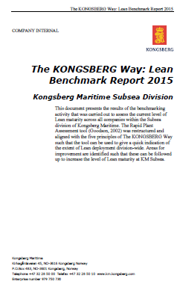
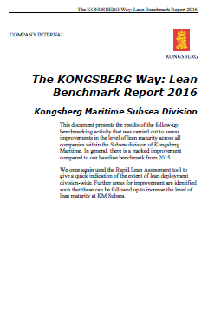
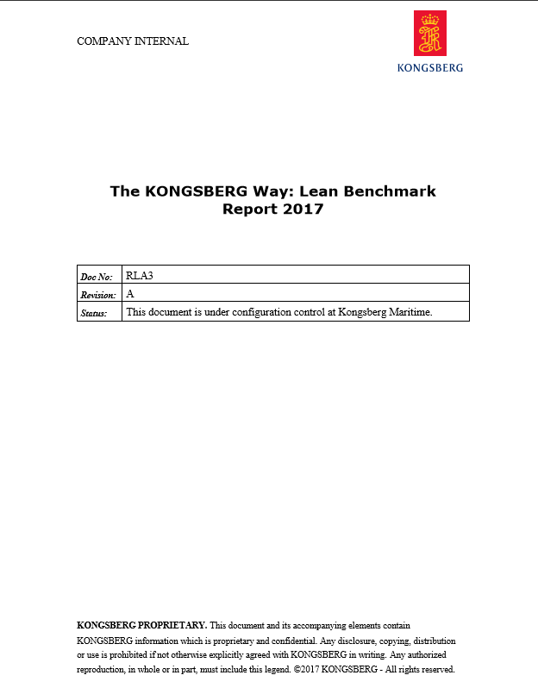
The KONGSBERG Way to lean transformation:
#GembaWalks & #RapidLeanAssessments

Slide 3
Ratings process (help & instructions)
The ratings process should proceed as follows:
Teams should tour the operation without notes or the charts and take in as much of the operation visually. Remember to compare the operation to its ideal you imagine; not to one you know.
Teams should meet immediately after the tour and discuss what they have seen during the tour giving each team member the opportunity to speak and summarize the good and the bad which they observed.
The team should thoroughly discuss all 11 ratings categories and 20 questions before assigning values of a yes or no.
After the general discussion and the ratings discussion, the team should go back and assign ratings and yes's or no's.
Remember the discussion is one of the main benefits of the tour and rating process. Do not short change the discussion.
Table 1 ratings must be 1, 3, 5, 7, 9, or 11. No other numbers are allowed.
To earn a yes in Table 2, the concept underlying the question should have been largely implemented. For example, if implementation is about 50%, that is a clear no. If implementation is at 90%, that is a clear yes. So, a yes indicates that the concept behind the question has been implemented in the operation.

Slide 4
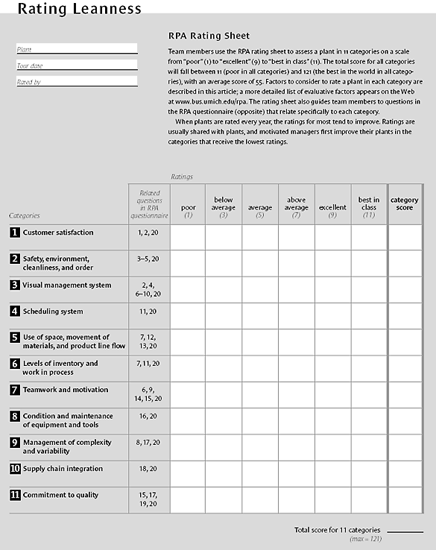


RPA Rating Sheet
PLUS…

Slide 5


Thank you

